Slide 1




Persons in employment,
main and secondary jobs
Wachyu Winarsih, M.Si
Head of Sub Directorate of Labor Force Statistics
Directorate of Population and Labor Force Statistics
BPS - Statistics Indonesia

Slide 2

BPS - Statistics Indonesia
Contents
Operational definition
Main updates to operational definition
Choice of reference period
Temporary absence from employment
Main job, multiple job holding
Notion of “for pay / profit”
Special cases
Tabulations and reporting documentation
Measurement in household surveys

Slide 3
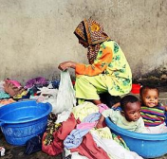

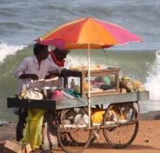

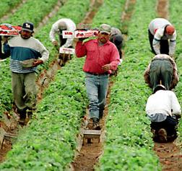
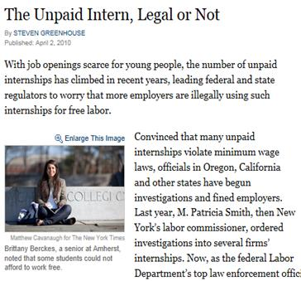
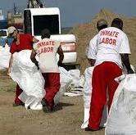

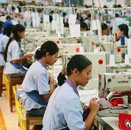
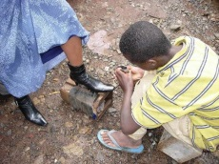
BPS - Statistics Indonesia
Form of work: Employment
Work
(i.e. ALL activities to produce goods and services)
For own final use
(by households)
For use by others (i.e. other units)
For remuneration (i.e. for pay or profit)
Without remuneration
Unpaid trainee work
Other work activities (e.g. unpaid compulsory work)
Volunteer work
Own-use production work
Employment
(work for pay or profit)
Services
Goods
Services
Goods
S
G
S
G
G
S

Slide 4
BPS - Statistics Indonesia
Persons in employment
Operational definition -19th ICLS (§ 27-32)
Two groups
  Employed, at work:
    Worked for pay or profit for at least 1 hour
  Employed, not at work:
    Worked already in the job, but not at work due to:
      Working time arrangement (shift work, flexitime)
      Temporary absence (expects to return within short period)
“Working age persons who in the reference week / last 7 days were engaged in any activity to produce goods or provide services for pay or profit”

Slide 5
BPS - Statistics Indonesia
Labour force status classification
Activity principle + priority rule + 1 hr. criterion
Working age population (a + b + c)
In short reference period,
worked for pay / profit for 1+ hours
NOT EMPLOYED
(without work for pay/ profit)
Y
N
With job for pay / profit, not at work
Seeking work for pay/profit
1st
N
Y
2nd
N
Y
Available
Y
N
a. Employed
3rd
b. Unemployed
Labour force (a + b)
c. Outside the labour force
ILO Department of Statistics
ILO Department of Statistics
5
5

Slide 6
BPS - Statistics Indonesia
1 hour criterion
Retained
Reasons
Ensures mutually exclusive and complete classification of working age population by labour force status
  Employed / Unemployed / Outside labour force
Covers all types of employment including short-time work, casual work, stand-by work, & other irregular employment
Captures employment by persons who may also be students, housewives, pensioners
Capture all labour inputs from employment activity into production (for national production accounts)

Slide 7
BPS - Statistics Indonesia
Persons in employment:
Main updates in operational definition
Based on accumulated national practice
  Refined short reference period for measurement
    Reference week, last 7 days (no longer alternative 1 day)
  Concept restricted to work for pay or profit
    New guidance to establish main intended destination of activity (for sale / for own final use)
  No more reference to status in employment groups
    Same treatment for all groups regardless of status in employment
    No optional hours’ threshold for contributing family workers
  Simplified guidance to determine temporary absence
    Job attachment assessed using reason for absence, and for certain reasons: total duration and continued remuneration

Slide 8
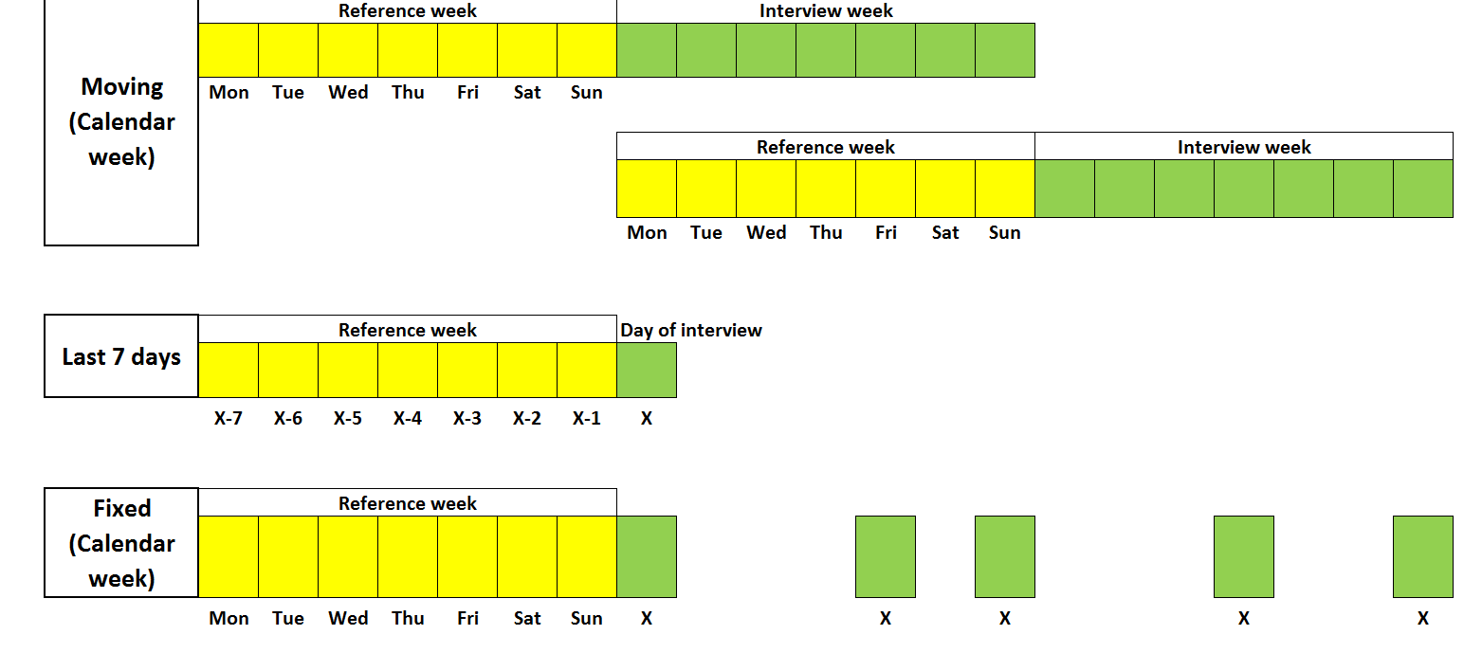
BPS - Statistics Indonesia
Choice of short reference period
Moving reference period
Last
calendar
week
Last 7
days
Fixed reference period
Week of
(DATE)

Slide 9
BPS - Statistics Indonesia
Temporary absence from employment:
Need to be short & keep job attachment
Reason
Reason (not sure job attachment)
Personal sick leave
  Short illness
  Occupational injury
Annual leave
  Public holidays
  Vacation
Maternity/paternity leave
  Compulsory period
Personal absence due to
  Education leave
  Parental leave, care for others, etc.
Strikes or lockouts
Reduction in economic activity
  Temporary lay-off
  Slack work
Work disorganization/suspension
  Bad weather
  Mechanical, electrical breakdown
  ICT problems
  Shortage of materials, fuel
Employed
Employed if short absence
(<3 months) and/or pay

Slide 10
BPS - Statistics Indonesia
Treatment during the
Low / off season
Employed if person continues to do some of the tasks / duties of the job
  Prepare, clear the land; maintain shop, order supplies ...
Not employed if tasks / duties of the job stop
Why ?
To capture seasonality of employment
To monitor demand for other jobs during off-season

Slide 11
BPS - Statistics Indonesia
Notion:
“For pay or profit”
Remuneration paid in cash or in kind
  Wages or salaries for time worked or work done
  Profits derived from sale / barter of goods and / or services produced (i.e. excludes production intended mainly for own final use)
Payable (i.e. whether actually received or not)
  Accommodates different pay periods, owed income etc.
Directly to person performing work or indirectly to a household or family member
  Includes contributing family workers (who help in household business)
    Their work contributes to the income received by the family

Slide 12
BPS - Statistics Indonesia
Main intended destination: For market / For own use
For self-employment
  Essential to establish that the production is intended mainly for use by other units (i.e. market-oriented)
  Even if products are not sold / bartered (e.g. bad season)
Need to test
Example
Q. In general, are [the products] obtained from this work intended mainly for sale/barter or mainly for your own family use?
1=Only for sale / barter
2=Mainly for sale / barter but some for own or family use
3=Mainly for own or family but some for sale/barter
4=Only for own or family use
Employment
Own-use production work

Slide 13
BPS - Statistics Indonesia
Self-employment activity
Consider as employed when:
  Activity intended to produce goods or provide services mainly for sale / barter
    Even if some of the production is kept for own/family use
  Ready to start operating
    Materials, resources are in place
    First order / clients are received
  Regardless of profit made or loss
  Formal / informal, fixed premises / mobile

Slide 14
BPS - Statistics Indonesia
Treatment of particular cases:
Participants in employment promotion programmes (e.g. labour intensive, skills training / re-training programmes, grants to start own business, )
  Employed if working for pay / profit
  Members of military (e.g. regular career members, temporary conscripts)
  Employed
Persons with a job while on training required by job
  Employed (at work)
Persons who have a job offer to start in future
  Not employed (has not yet started to work)
Persons with right to return to a job, but on extended absence (e.g long-term education leave)
  In principle, not employed (if paid, countries may decide)

Slide 15
BPS - Statistics Indonesia
Quiz (1): Employed or Not employed ?
Student who works on weekends at a supermarket for tips
  Employed
Student doing an unpaid internship at a business
  Not employed (unpaid trainee work)
Student who helps tutor children during after-school hours
  Not employed (volunteer work)
Homemaker who washes and irons clothes for pay
  Employed
Pensioner who drives a taxi in the evenings
  Employed
Farmer who grows rice mainly for family consumption, and from time to time sells the surplus to neighbors
  Not employed (own-use producer of goods)

Slide 16
BPS - Statistics Indonesia
Quiz (2):
Employed (at work/not at work) or Not employed ?
Tuk tuk driver standing in the corner waiting for clients
  Employed, at work
Office secretary away on maternity leave
  Employed, not at work
Teacher away at a conference
  Employed, at work
Fisherman staying at home during the monsoon season
  Not employed
Informal whole sale trader waiting at home for new shipment
  Employed, at work (if he operates his business from home)
Government employee on education leave for 3 years
  If receiving pay, as per country decision, otherwise Not employed

Slide 17
BPS - Statistics Indonesia
Job §12(b)
Revised definition
“set of tasks and duties performed,
or meant to be performed,
by one person for a single economic unit”
Restricted to Employment
  ≈ “Work activity” for other forms of work
Avoids reference to Status in Employment categories
  As ICSE-93 is currently under revision
Links “job” to a single economic unit
  May be a market-unit, non-market unit or household

Slide 18
BPS - Statistics Indonesia
Multiple job holding & Main job §12(b)
Revised definitions
Multiple job-holding:
Main job: That in which the person usually works the most hours, even if absent in the short reference period
  If same hours, then highest income. If same income, then as self-declared
  Emphasizes integration with national accounts (labour input)
Job(s) of self-employed: # of economic units owned or co-owned
  Not number of clients served
  Difficult to assess in the case of informal self-employment activities
  For informality, recommended to separately identify activities in different industries

Slide 19
BPS - Statistics Indonesia
Quizz: How many jobs, which is the main?
Full-time government employee, on vacation in the reference week, who also teaches a one-hour class twice a week
  Two jobs, main job is as government employee
Person who works for the education department, teaching in the mornings at one school and afternoons at another school
  One job (if in both cases, paid by the education department)
Self-employed person who has a hardware shop and also works as a plumber on weekends
  Two jobs, main job is as owner of hardware shop
Farmer who grows vegetables for sale and also spends a few hours a week manufacturing brooms for sale
  Two jobs (different industries), main job as vegetable grower

Slide 20
BPS - Statistics Indonesia
Persons in employment:
Measurement in household surveys
Need to identify persons with all types of jobs
  Need to add several questions
Questions should be appropriate for persons in all types of jobs
  Self-employment jobs (employer, own account worker, contributing family worker)
  Employee jobs (permanent, temporary, casual, including as paid apprentice)
Useful to include examples in the questionnaire of most common types of jobs/activities likely to go unreported
  casual, informal and/or part-time jobs
  Or use an activity list

Slide 21
BPS - Statistics Indonesia
Main and secondary jobs:
Measurement in household surveys
For main job: Useful to include introductory statement
  “The next questions are about the main job held last week, that is, the one in which (NAME) usually works the most hours, even if he/she was absent last week”
For secondary jobs: Useful to have statement to reduce underreporting
  “Nowadays, with current economic conditions, many people have two or more jobs, last week did you have any other job or business activity, even if you were temporarily absent”
Measure for all jobs:
  Working time; employment-related income (if included in survey)
Essential characteristics of 2nd jobs, only if prevalent in the country
  Occupation, Industry, Status in Employment, Institutional sector
  May be measured on a non-frequent basis to reduce burden
  Detailed characteristics if assessing size of informal economy

Slide 22
BPS - Statistics Indonesia
Basic labour force survey structure
0+
Module I: Household Roster & Demographic Characteristics
n+
Module II: Education & training
WAP
Module III: Participation in the Labour Market
Identification of persons in employment
Y
1st
N
Persons in employment
Persons NOT in employment
-Characteristics of main job
-Characteristics of other jobs
2nd
3rd
-Job search & availability
-Previous employment experience
Module IV: Participation in Own use production of goods
Optional Work modules:
Unpaid trainee work
Volunteer work
Provision of services for own final use

Slide 23
BPS - Statistics Indonesia
Questionnaire flow
WORKING AGE POPULATION
Worked for pay / profit
for 1+ hours
NOT EMPLOYED
(without work for pay/ profit)
N
Y
With job, not at work
N
Y
Reason of absence
Duration
≤3 mo.
>3 mo.
Pay
N
Y
E
ILO Department of Statistics
23

Slide 24
BPS - Statistics Indonesia
Illustration (1)
During the last 7 days, did [NAME] do any work for a wage, salary, commission or other pay in cash or in kind, even if only for 1 hour?
(examples: …)
  YES → Section: Characteristics of main job
  NO
Did [NAME] work in his/her own business activity, to generate income, even if only for 1 hour? (examples: ….)
  YES → Section: Characteristics of main job
  NO
Did [NAME] help without pay in a business operated by a household or family member?
  YES → Section: Characteristics of main job
  NO
Employed
Employed
Employed

Slide 25
BPS - Statistics Indonesia
Illustration (2)
During the last 7 days, did [NAME] have a job or business from which he / she was temporarily absent?
  YES
  NO → Section: Job search
What was the reason why [NAME] was absent?
  Shift work
  Vacation, Holidays → Section: Characteristics of
  Short illness main job
  Maternity, paternity leave
  Other personal leave
  Off season → Section: Job search
  Slack work, lack of materials, mechanical breakdown
  Bad weather
Not employed
Employed
Not employed

Slide 26
BPS - Statistics Indonesia
Illustration (3)
Counting the time [NAME] has been absent, will he / she return to work…
  Within 3 months? → Section: Characteristics of main job
  After 3 months?
During the absence, does [NAME] continue to receive pay?
  Yes → Section: Characteristics of main job*
  No → Section: Job search
(*) As per national context
Employed
Employed
Not employed

Slide 27
BPS - Statistics Indonesia
Activity list example: Q. to identify Employed, at work
Q1. In the last week did you do any work for pay or profit?
Yes → EMPLOYED
No
Q2. Did you do any of the following activities, even if only for one hour, in exchange for pay or to generate income…?
Farming, animal husbandry or fishing mainly for sale
Prepared food, manufactured textiles, crafts or tobacco
Cleaned houses, washed, iron clothes for others, fixed clothing or shoes
Sold beauty products, clothing, jewelry, order by catalog
Fixed electro domestic equipment (iron, washing machine, cell phones,…)
Yes → EMPLOYED
No
Q3. Did you help without being paid in any kind of business run by your household, even if it was for only one hour? Yes → EMPLOYED
No

Slide 28
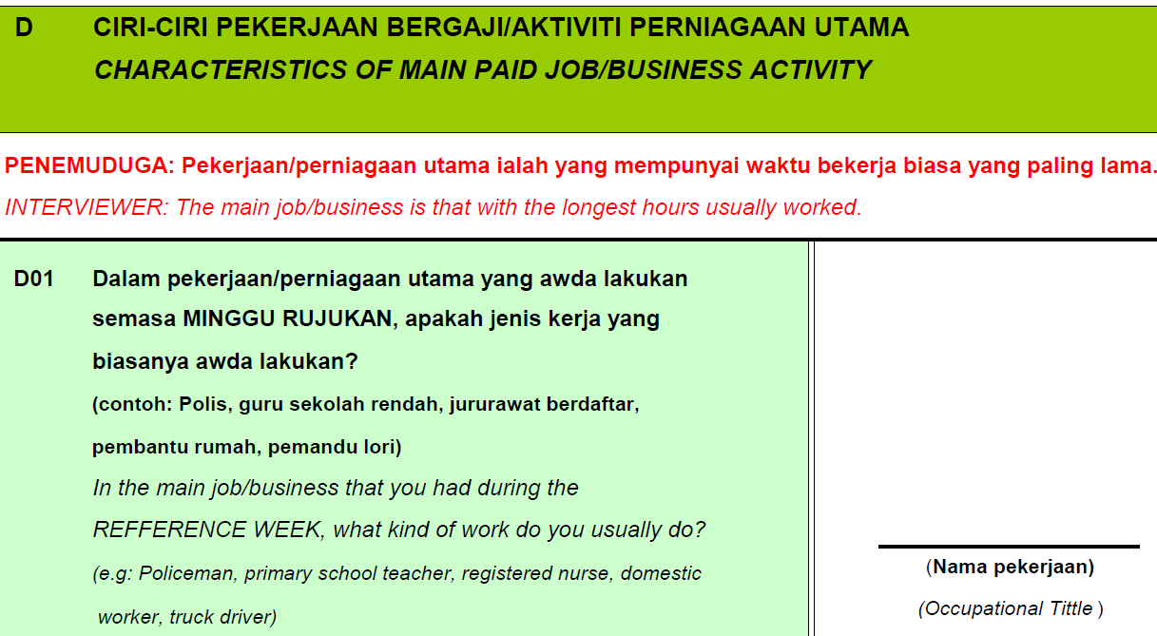
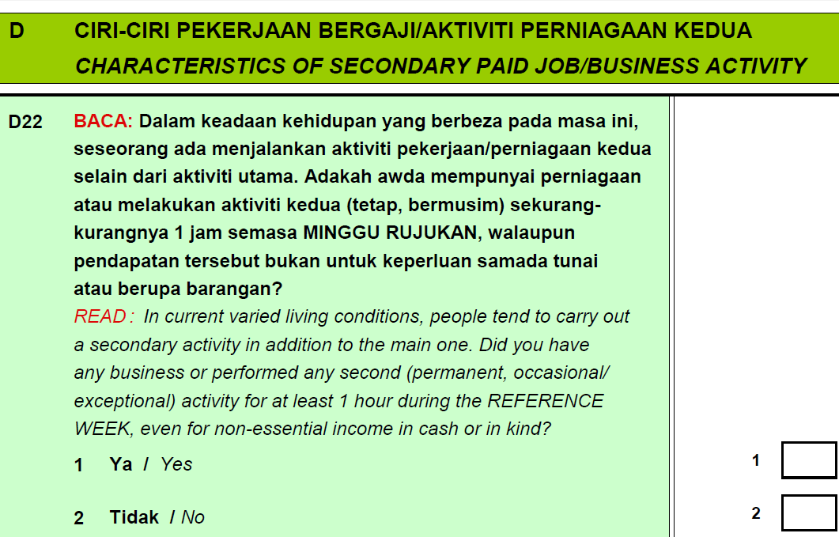
BPS - Statistics Indonesia
Main and secondary jobs: Illustration (1)
ILO Department of Statistics
28

Slide 29
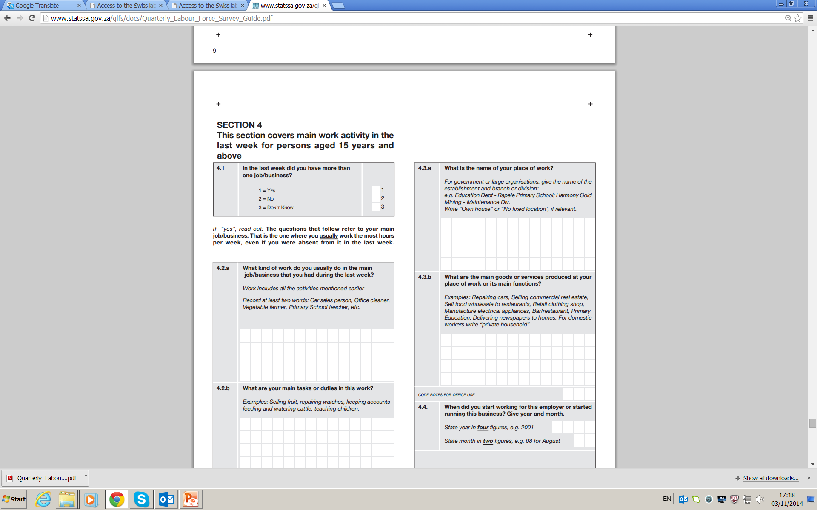
BPS - Statistics Indonesia
Main and secondary jobs:
Illustration (2)

Slide 30
BPS - Statistics Indonesia
Tabulations and Reporting documentation

Slide 31
BPS - Statistics Indonesia
Tabulations – Employment (1)
Statistics of forms of work (including employment) should be systematically tabulated by sex, specified age groups, level of educational attainment and by region, including urban and rural areas.
For a descriptive analysis of participation in the labour market, tabulations should include:
(a) working-age population by labour force status (including employment) and transitions (gross flows) between statuses, where possible
(b) persons in employment by characteristics of their current job(s), such as:
  industry
  occupation
  status in employment
  type of economic unit (formal market units/informal market units/non-market units/households)
  institutional sector
  geographic location of place of work
  type of remuneration
  specified bands of employment-related income
  specified working-time hour bands

Slide 32
BPS - Statistics Indonesia
Tabulations – Employment (2)
Tabulations of the total number of jobs in resident producer units are recommended by:
  industry
  specified working-time hour bands
  type of economic unit (formal market units/informal market units/non-market units/households)
Employment often depends on family or household-level characteristics, particularly in rural areas of developing countries, thus recommended to prepare tabulations for:
  persons in employment, by marital status and by presence of dependents or persons requiring care (young children, the elderly, others);
  households, by number of working-age members according to their labour force status and main form of work, by main sources of income (income from self-employment, from wage employment, from own-use production work, and other sources), by bands of household income;
  households without members in employment and households with members who are subsistence foodstuff producers, by size, composition, main sources of income and other relevant economic and social characteristics.

Slide 33
BPS - Statistics Indonesia
Reporting documentation
To enhance transparency, statistics should be reported with regard to:
  scope and coverage
  concepts and definitions
  any estimation or adjustment methods, including seasonal adjustments or imputation procedures
  where possible, measures of data quality and precision, e.g., relative standard errors that account for complex survey designs
Revisions, new time series or indicators should be adequately indicated and documented, e.g. publication of dual estimates or series, for at least one year, following their implementation.

Slide 34
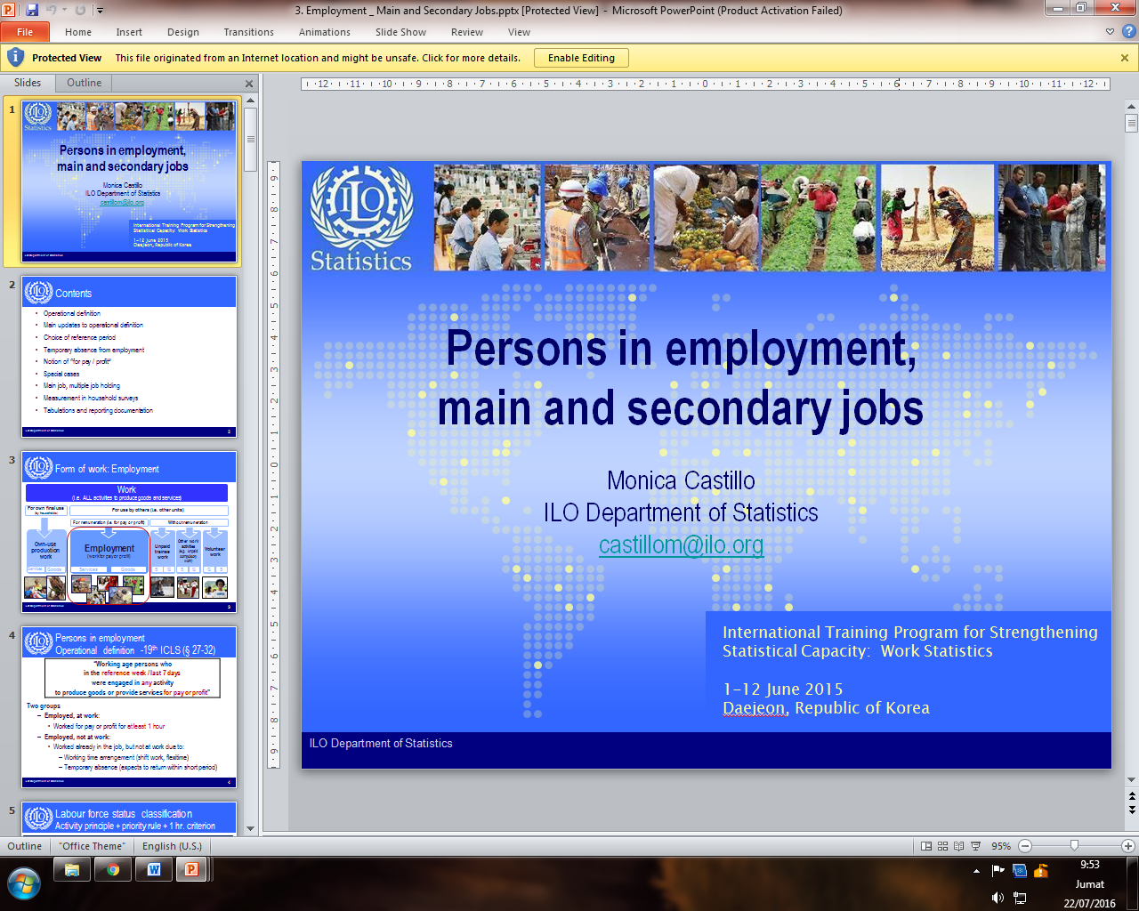
BPS - Statistics Indonesia
References:

Slide 35
Thank you

