Slide 1

MUSLIM FRIENDLY
TOURISM (MFT)
MARKETING IN TURKEY
Turkish Ministry of Culture and Tourism
Directorate General of Promotion

Slide 2
Contents
About Turkey
Comcec
2023: The 100th Anniversary of Republic of Turkey
Turkish Tourism in Numbers
Main Markets 2017
Turkey Offers
Promoting Turkey
Directorate General of Promotion
Advertising Campaign
Digital and Social Media Campaigns / Aim
Competitive Information
2017 Advertising Campaign
Muslim Friendly Tourism (MFT)
Global Muslim Travel Index
Global Muslim Travel Index
Muslim Travel Shopping Index
Muslim Friendly Products and Halal Tourism
Muslim Friendly Products and Halal Tourism in Turkey
Muslim Friendly Products and Halal Tourism Standarts
Halal Tourism Conferences

Slide 3
About Turkey
Member of United Nations since 1945
Member of UNESCO since 1945
Member of Council of Europe since 1949
Member of NATO since 1952
Member of OECD since 1961
Member of World Tourism Organization since 1975
Candidate for European Union since 2005
Member of The United Nations Security Council 2009-2010

Slide 4

2023: the 100th Anniversary of Republıc of Turkey
Targets:
Tourist arrivals: 50 million
Tourism revenue: $ 50 billion
Top Destinations Ranking 5th in the world

Slide 5
Turkish Tourism in Numbers
Source: Turkish Ministry of Culture and Tourism

Slide 6
Turkish Tourism in Numbers
Source: Turkish Ministry of Culture and Tourism

Slide 7
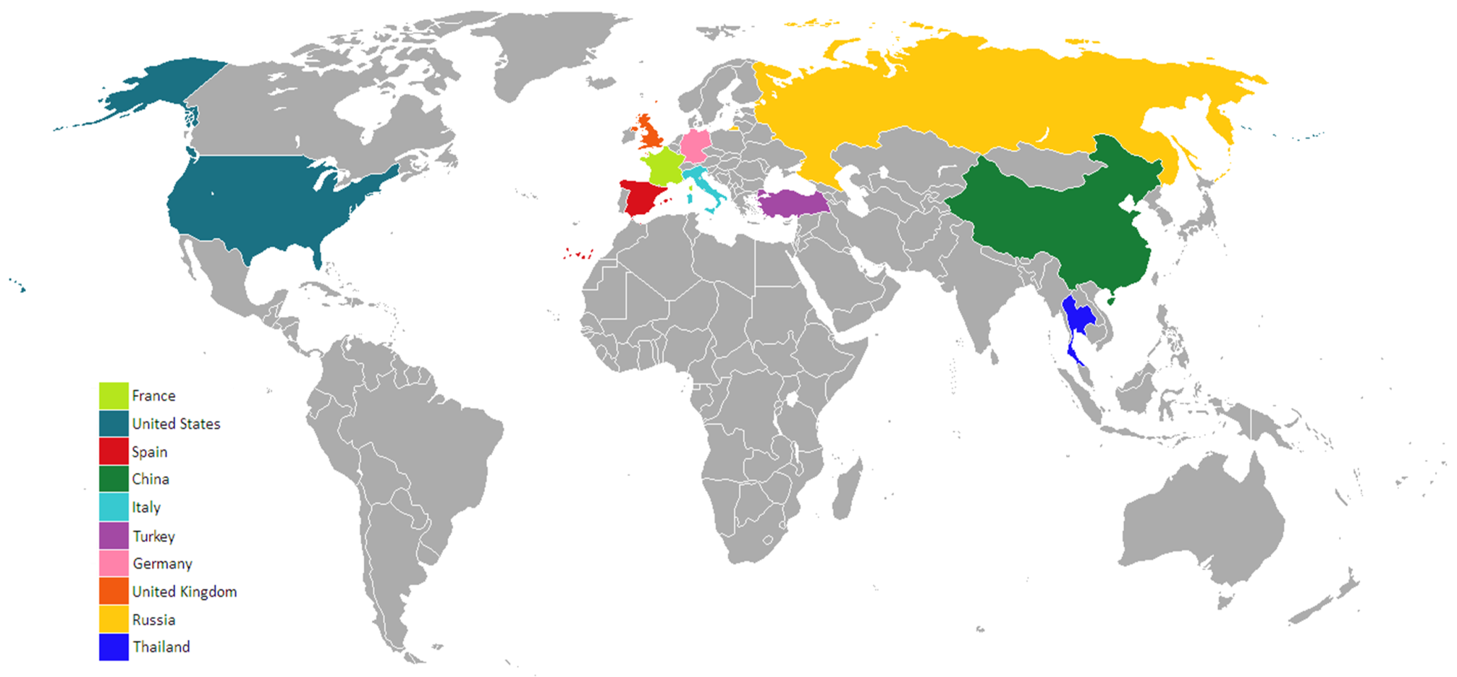
SIXTH MOST VISITED COUNTRY IN THE WORLD
Source: UNWTO Statistics

Slide 8
Main Markets 2017 (January-May)
RUSSIAN FED. | 608 472
GERMANY | 295 007
GEORGIA | 235 462
UK | 188 102
BULGARIA | 165 625
Source: Turkish Ministry of Culture and Tourism

Slide 9
Turkey Offers
At least 13 civilisations
171 archeological excavations
79 antique cities
300+ historical sites
350+ Environmental Friendly (Green star) Accommodation Facilities
Source: Turkish Ministry of Culture and Tourism

Slide 10

Turkey Offers
Two of the Seven Wonders of The World are in Turkey
(Temple of Artemis and Mausoleum of Halicarnassus)
House of the Virgin Mary is in Ephesus
Catalhoyuk is one of the first settlements in the world (One of the sites in the UNESCO World Heritage List)
The first temple of the world found in Gobeklitepe (Şanlıurfa)
The famous Tulips are originally from Turkey
The first coins were minted in Lydia (Southwestern Turkey)
16 sites in the UNESCO World Heritage List by 2016
60 sites in the UNESCO Tentative List by 2016
Source: Turkish Ministry of Culture and Tourism

Slide 11
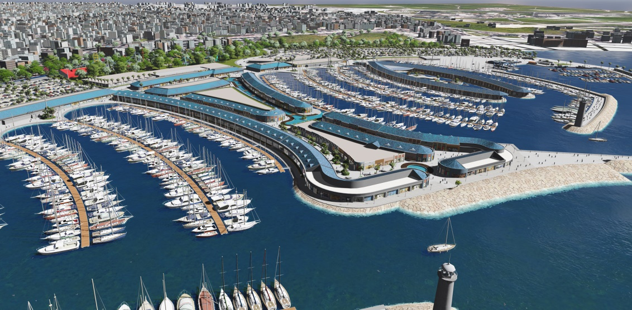
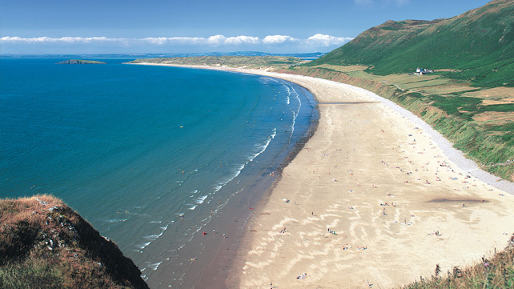

Turkey Offers
8.333 km coastline
33 marinas
Blue Flags
436 beaches (2015)
Turkey ranks 2nd with beaches in the world

Slide 12
Promoting Turkey
FULLY
CUSTOMER SATISFACTION
INTEGRATED
MARKETING
COLLABORATE
FOLLOW CUSTOMER TRENDS
ANALYSE THE MARKETS
IMPROVE OUR PRODUCTS

Slide 13
Directorate General for Promotion
45 Cultural and Tourism Offices in 40 countries,
The new promotion strategy of developing and growing Turkey with a respected worldwide brand
      Forming the country perception correctly,
      Coordination,
      Sectoral efficacy.

Slide 14
Advertising Campaign
Over 100 countries with a budget over USD 50 million,
On traditional channels like print media, outdoor, tvs, radios etc.,
On social media and digital platforms
A global image campaign which is wholistic, monophonic and contains our entire values;
Turkey Home.

Slide 15

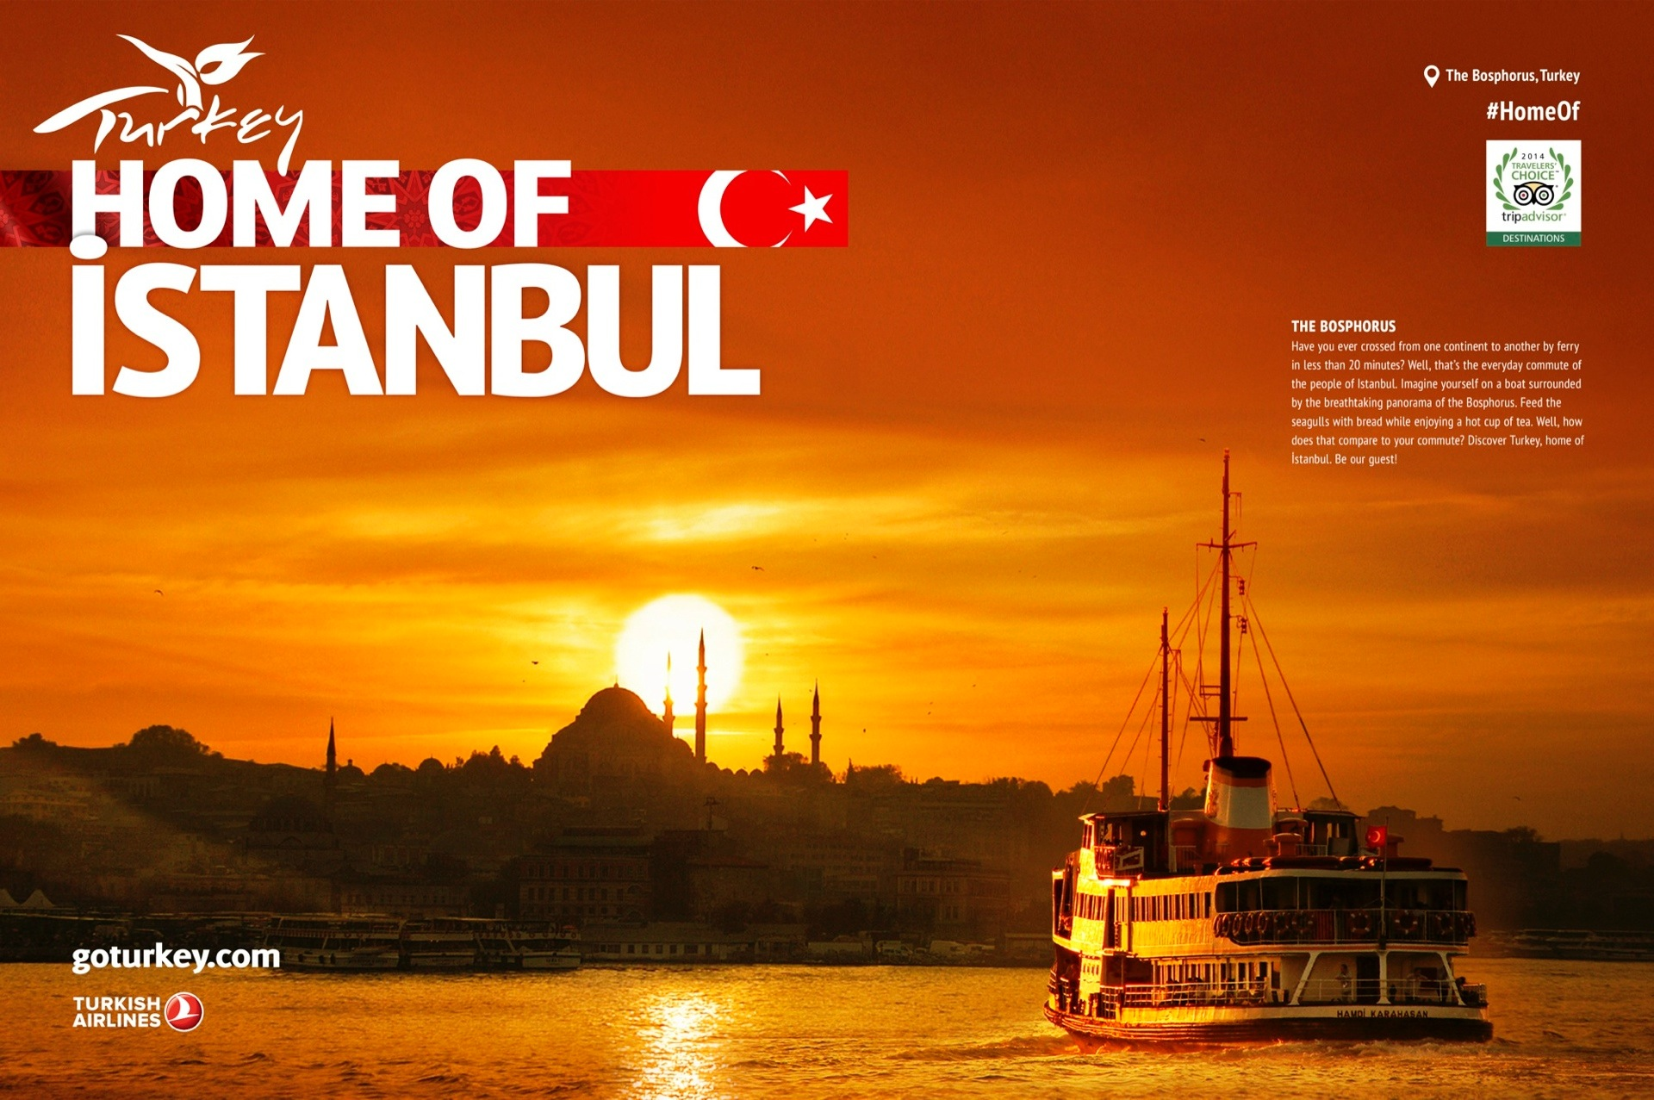

Slide 16

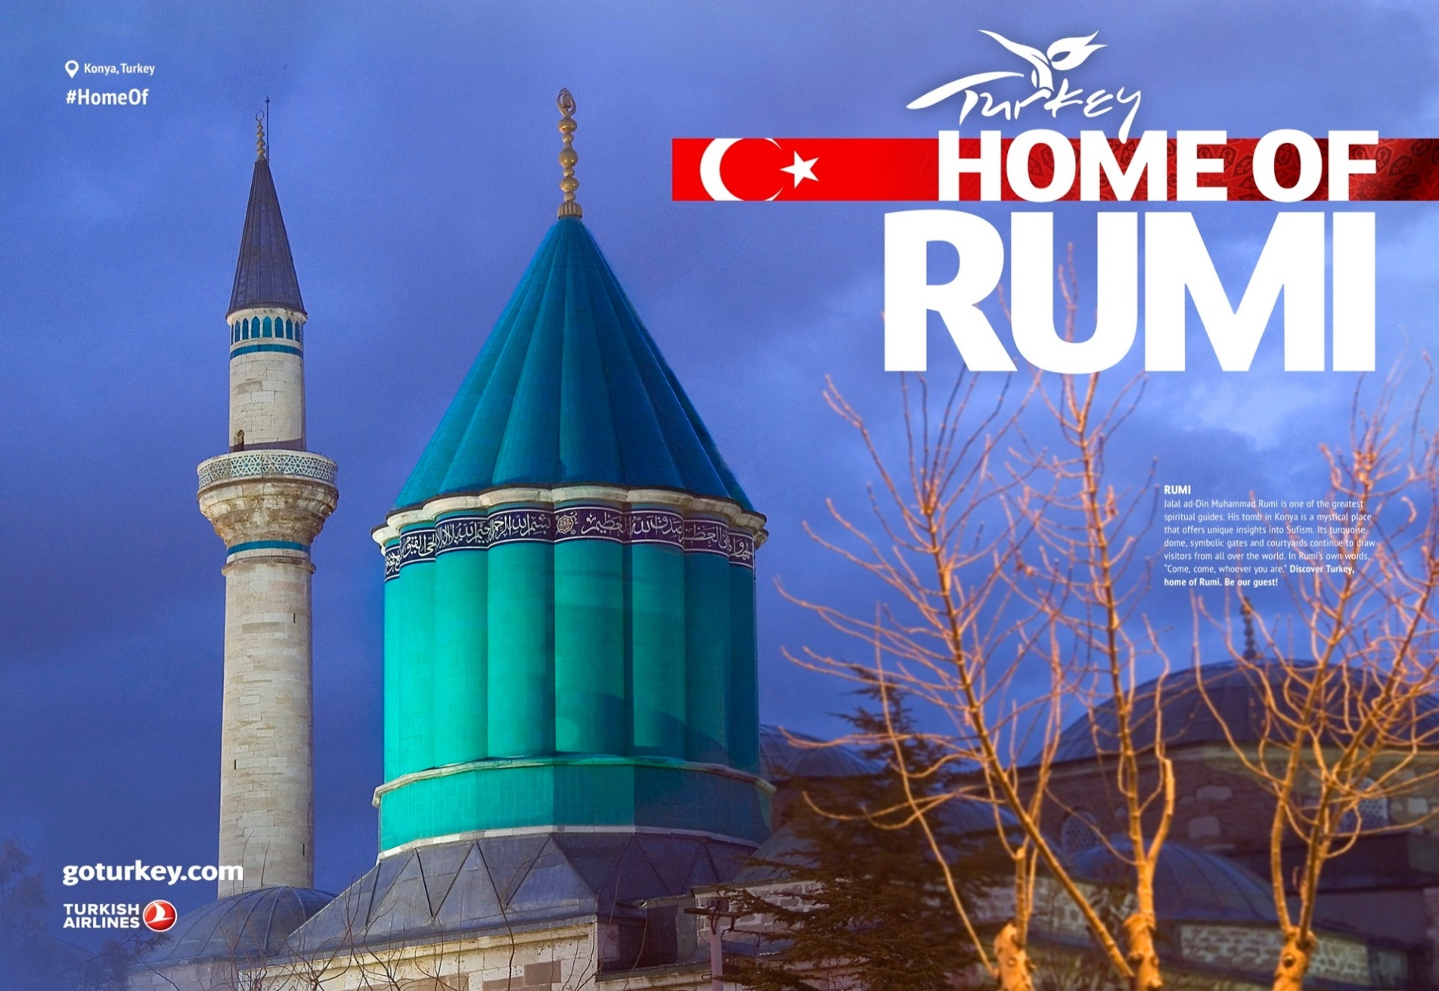

Slide 17
Digital and Social Media Campaigns / Aim
Strategic partnerships with the world’s most powerful digital and social platforms
Sustainable development of the tourism potential of Turkey
Effective promotion on a global base
Turkey’s cultural values and tourism products

Slide 18
Competitive Information

Slide 19
Muslim Friendly Tourism (MFT)
The Muslim population is growing rapidly and is expected to reach 26 percent of the world’s population by 2030.
The growth of the Muslim population and their increasing disposable income have resulted in a large number of Muslims taking up travel for leisure, business, healthcare and religious reasons.
This increase has resulted in Muslim travelers becoming one of the fastest growing travel segments in the tourism industry.
Source: Muslim Friendly Tourism, Understanding the demand and supply sides the OIC Member Countries , February, 2016.COMCEC Report

Slide 20
Muslim Friendly Tourism (MFT)
23% of the world’s population in 2014 was Muslim
26% of the world’s population is projected to be Muslim in 2030.
50% of Muslims are under the age of 25 years.
During the last few years, awareness and adoption of faith-based practices by Muslim travellers have also been growing.
Having halal food options at a destination is “very important” when choosing a holiday destination
Source: Muslim Friendly Tourism, Understanding the demand and supply sides the OIC Member Countries , February, 2016.COMCEC Report

Slide 21
Muslim Friendly Tourism (MFT)
Muslim visitors arrivals and expenditure, 2000 to 2020
2000 | 2014 | 2020
25 Million Visitors $ 20 Billion | 116 Million Visitors $ 121 Billion | 180 Million Visitors $ 212 Billion
Source: Muslim Friendly Tourism, Understanding the demand and supply sides the OIC Member Countries , February, 2016.COMCEC Report

Slide 22
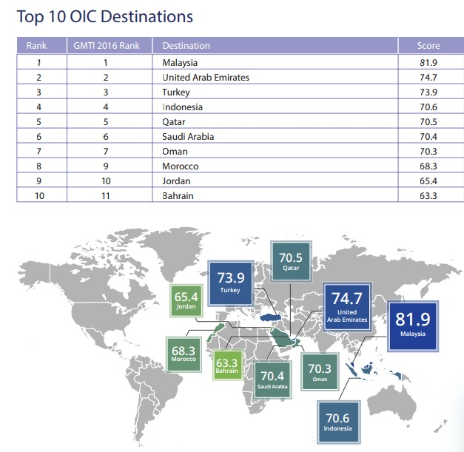
Global Muslim Travel Index
Source: MasterCard and Crescent Rating, 2016

Slide 23
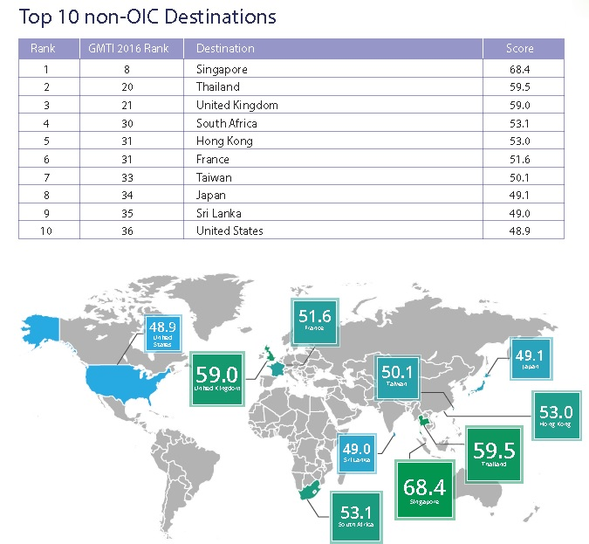
Global Muslim Travel Index
Source: MasterCard and Crescent Rating, 2015

Slide 24
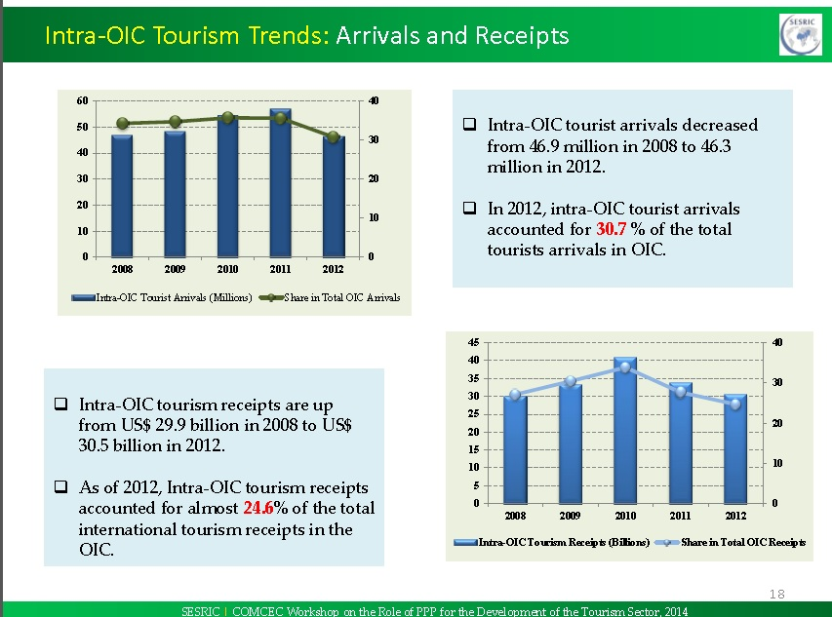
Intra-OIC Tourist Arrivals & Receipts

Slide 25
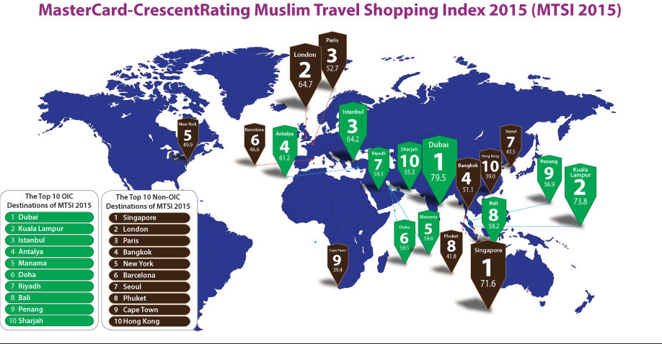
Muslim Travel Shopping Index
Source: MasterCard and Crescent Rating, 2015

Slide 26
Muslim Friendly Products and Halal Tourism
A Euromonitor International report released at World Travel Market in 2007 in London says that there is potential for a boom in halal tourism in the Middle East.
The report mentions a market for a halal startup airline, which could provide halal food, prayer calls, Qur’an in seat pockets and provide separate sections for male and female travelers.

Slide 27
Muslim Friendly Products and Halal Tourism
Halal tourism is a subcategory of tourism which is geared towards Muslim families who abide by rules of Islam.
The hotels in such destinations do not serve alcohol and have separate swimming pools and spa facilities for men and women.
Malaysia, Turkey and many more countries are trying to attract Muslim tourists from all over the world offering facilities in accordance with the religious beliefs of Muslim tourists.
Currently, there exists no internationally recognized standards on Halal tourism.

Slide 28
Muslim Friendly Products and Halal Tourism
Faith- based needs and services
As a rich market “halal friendly” tourism includes; halal hotels, halal transport (halal airlines), halal food restaurants, halal tour packages and halal finance. Therefore, halal tourism consists of different sectors which are related with each other.

Slide 29
Muslim Friendly Products and Halal Tourism in Turkey
Turkey offers all kinds of halal products for muslim friendly travelling
-Turkey is a Muslim country
-Turkey has halal hotels, escipecially in İstanbul, Antalya, Muğla, Bursa and Konya
-Turkey has lots of halal food restaurants
-Turkey offers halal transports also.

Slide 30
Muslim Friendly Products and Halal Tourism in Turkey
Turkey offers all halal products for muslim friendly travelling
-Turkey has 150 accommodation facilities
-Turkey has Muslim Friendly tour agencies
-Turkey offers to be able to do prayer (salaath) facilities. The Muslims can wudhu and pray wherever they want during their travel in Turkey
-Turkey has 87.000 mosques. İstanbul has 3.200 mosques

Slide 31
Muslim Friendly Products and Halal Tourism in Turkey
Turkey is an Islamic Tourism Centre
Turkey has many religious &haritage sites.
Turkey offers attractions, shopping, beaches, segregated thermal and swimming pools (for males and famales) nature, adventure, live events for leisure travel, escipecially in RAMADHAN.
Ramadhan Services
Organising Muslim Friendly events.
Halal hospitals, healthcare services
Water friendly washrooms

Slide 32
Muslim Friendly Products and Halal Tourism in Turkey
Religious Travel- Hajj, Umrah and to the other Islamic cities.
Leisure Travel- Sightseeing, Shopping & Dining Visiting friends and relatives
Honeymooners
Discovering Islamic Heritage and Muslim History
Adventure seekers
Local cultural experience
Business Travel – Healthcare Travel

Slide 33
Muslim Friendly Products and Halal Tourism Standarts
Three Main Constitutions in Turkey
SESRIC- Statistical, Economic and Social Research and Training
Centre for Islamic Countries
SMIIC-The Standards and Metrology Institute for Islamic Countries
TSE- Turkish Standards Institution- gives certification for halal foods and cosmetics
Turkey has halal food standarts and certifications
Turkey is studying for halal products standarts

Slide 34
Halal Tourism Conferences
1st Organization of Islamic Cooperation (OIC) International Forum on Islamic Tourism was on 2-3 June 2014 hosted by Indonesia.
The Halal Tourism Conference 2014 hosted in Granada, Spain, which was the first of its kind in a European country, as well as the World Halal Travel Summit in October 2015 held in Abu Dhabi.
The 2nd Halal Tourism Conference was hosted in May 2016 in Konya, Turkey. Konya was Islamic Tourism Capital for 2016.

Slide 35

TEŞEKKÜRLER شكراً

