Slide 1

Integration of Traditional and Complementary Medicine in Uganda National Health System
By
Dr. Sekagya H. Yahaya
(National Drug Authority)
(PhD – Student)

Slide 2
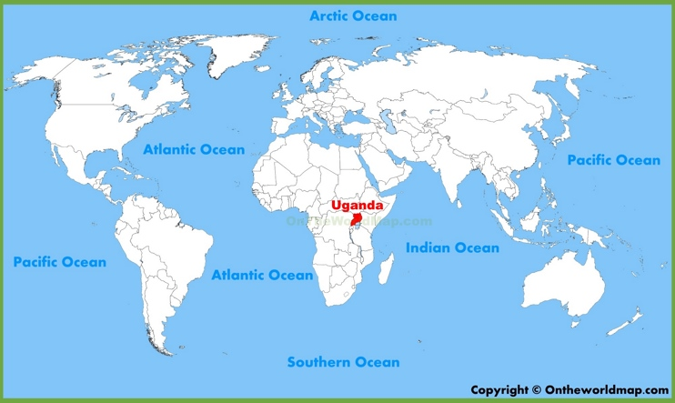

Slide 3
Types of TCM Applications in Uganda
Natural Chemotherapeutic laboratory, under MoH handles TCM, but lacks full mandate of registration
Most applications regard
  Herbalism
  Chinese traditional medicine
  Reflexology
  Homeopathy
  Acupuncture
  Ayurveda

Slide 4
National Policy, Regulations & Mechanisms ensuring Quality of TCM Services: (Practices, Practitioners and Products)
TCM Regulatory Bill & Policy Framework in Parliament (2nd Mention)
  intended to establish functional relationship between TCMP & health sector.
National Drug Policy and Authority Act 1993
  For Medical Products (not cosmetics, Not Practices, Not Practitioners)
The Second National Health Policy 2010
National Policy on Public Private Partnership in Health 2012
The Health Sector Strategic and Investment Plan 2011-2015
Health Sector Development Plan 2015 - 2020

Slide 5
Outdated Acts of Parliament
TCM can take advantage of, during amendments
Public Health Act 281
The Mental Treatment Act Cap 279
The witchcraft Act of 1957
Other Acts to consider
  Local Government Act Cap 243
    (Gap; The policy does not regulate TCM practitioners and their services)
  The Penal Code Cap 120
    (Gap; The Act has no provisions regarding TCM who commit offences in service delivery)

Slide 6
Standardization of TCM Education and Trainings (Regulations, Quality assurance, Standards)
TCM practices & practitioners insufficiently regulated by MoH
  No system for licencing/tracking practitioners + products
  Quality is not assured, Unsubstantial claims (many)
No strong provision for standards; education & training
There is not professional regulatory body of TCM
  Is TCM a Profession?

Slide 7
Initiatives to train TCMP (THPs)
  Natural Chemotherapeutic Institute (in formation)
  PROMETRA Uganda (NGO)
  THETA Uganda (NGO)
  Public Universities
    Makerere University – (Undergraduate)
    Mbarara University (MSc and PhD program)
    Gulu University (Diploma – course unit)

Slide 8

Dr. Sekagya H. Yahaya
UGANDA
E-mail: ysekagya@gmail.com
Phone: +256 772 403 900

